Slide 1
An Introduction to
Software Architecture
Software Engineering Lab.
Summer 2006

Slide 2
Definition
The software architecture of a program or computing system is the structure or structures of the system, which comprise software elements, the externally visible properties of those elements, and the relationships among them.

Slide 3
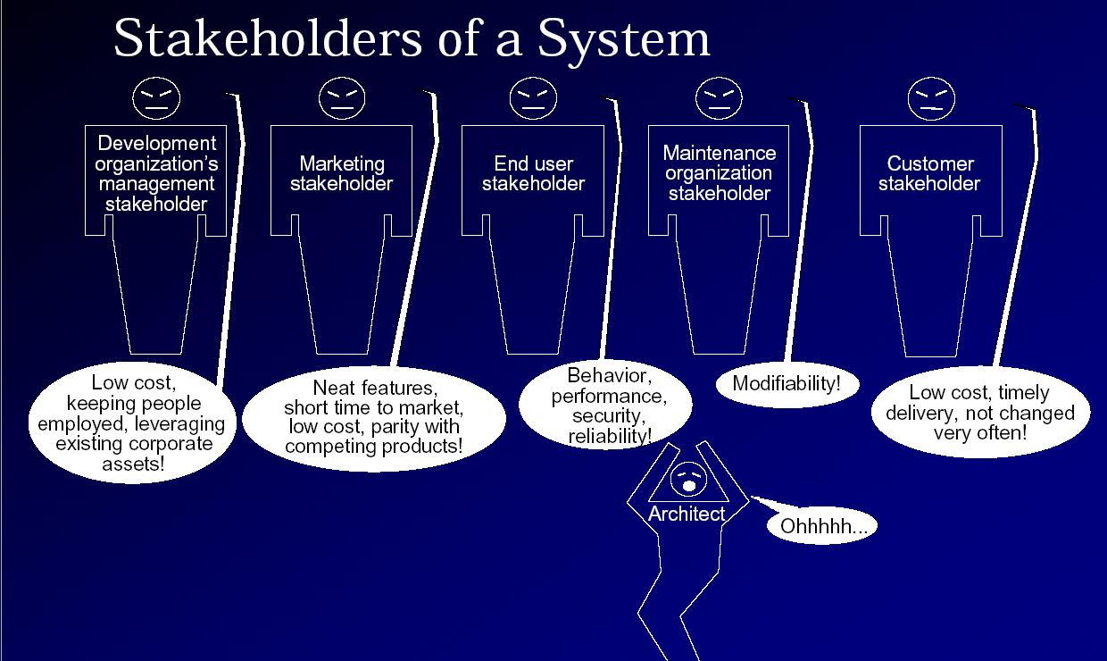
Who influences SA?

Slide 4
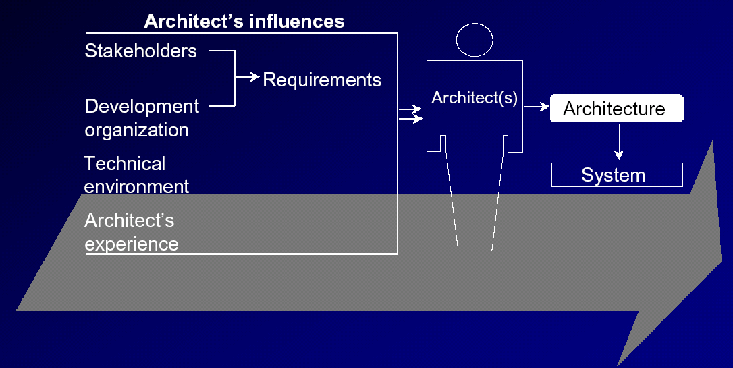
Summary: Influences on the Architect

Slide 5
Why is architecture important?
Handling complexity
Communication among stakeholders
Early Design Decisions
SA is a transferable, reusable model

Slide 6
Software Architecture Document
Introduction
Architectural Representation
Architectural Goals and Constraints
Use-Case View
Logical View
Process View
Deployment View
Implementation View
Data View (optional)
Size and Performance
Quality

Slide 7
Architectural Patterns : Definition
An architectural style or pattern is
  a description of the component and connector types involved in the style
  the collection of rules that constrain and relate them

Slide 8
Model-View-Controller
Context
  Provides a flexible structure for developing interactive applications.
Problem
  User interfaces are subject to changes. As new features are added to the system, the UI must provide appropriate command and menus to handle them.
  Different platforms support different ‘look and feel’ standards; the UI must be portable.
  Different kind of users may expect different data format from the UI (bar char, spreadsheet etc.).
Solution
  Divide the system into three parts: processing, output, and input:
  Model: contains the processing and the data involved.
  View: presents the output; each view provides specific presentation of the same model.
  Controller: captures user input (events-> mouse clicks, keyboard input etc.). Each view is associated to a controller, which captures user input.

Slide 9
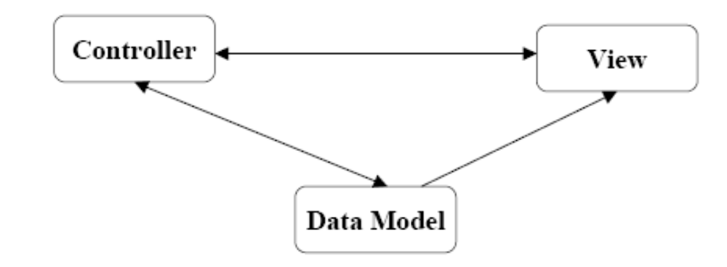
Model-View-Controller
Main goal:
  facilitate and optimize the implementation of interactive systems, particularly those that use multiple synchronized presentations of shared information.
Key idea:
  separation between the data and its presentation, which is carried by different objects.
Controllers typically implement event-handling mechanisms that are executed when corresponding events occur.
Changes made to the model by the user via controllers are directly propagated to corresponding views. The change propagation mechanism can be implemented using the observer (design) pattern.

Slide 10
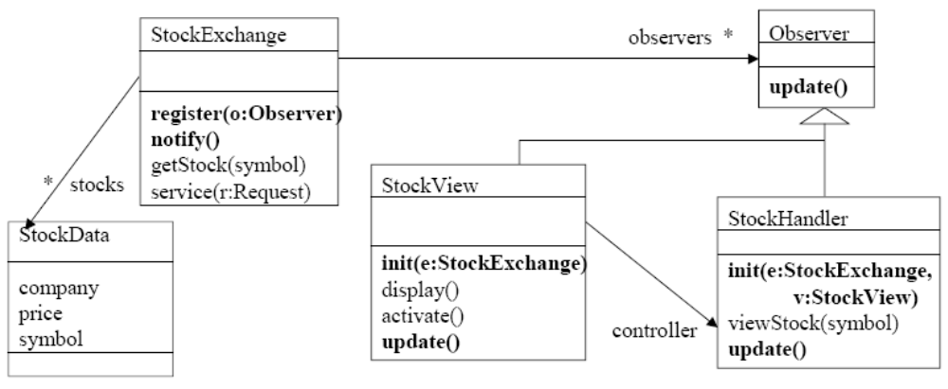
A Stock Trading Application

Slide 11
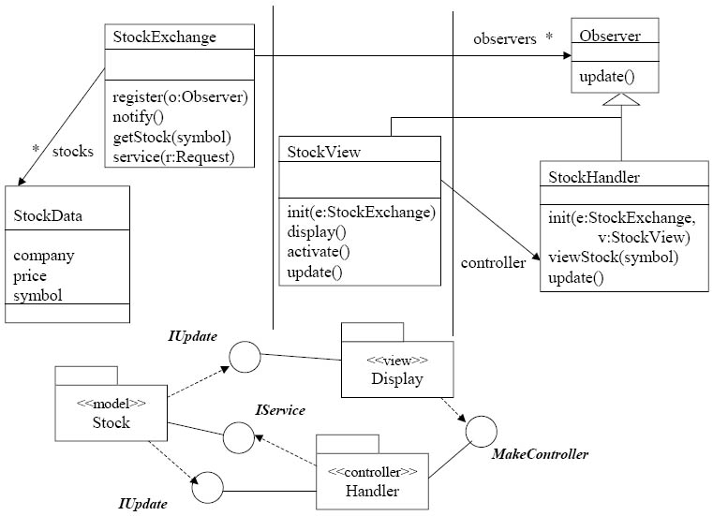

Slide 12
Layered Pattern
Context
  You are working with a large, complex system and you want to manage complexity by decomposition.
Problem
  How do you structure an application to support such operational requirements as maintainability, scalability, extensibility, robustness, and security?
Solutions
  Compose the solution into a set of layers. Each layer should be cohesive and at Roughly the same level of abstraction. Each layer should be loosely coupled to the layers underneath.

Slide 13
Layered Pattern
Layering consists of a hierarchy of layers, each providing service to the layer above it and serving as client to the layer below.
Interactions among layers are defined by suitable communication protocols.
Interactions among non-adjacent layers must be kept to the minimum possible.
Layering is different from composition
  higher-layers do not encapsulate lower layers
  lower layers do not encapsulate higher layers (even though there is an existence dependency)

Slide 14
Three-Layered Pattern
Context
  You are building a business solution using layers to organize your application.
Problem
  How do you organize your application to reuse business logic, provide deployment flexibility and conserve valuable resource connections?
Solutions
  Create three layers: presentation, business logic and data access.
  Locate all database-related code, including database clients access and utility components, in the data access layer.
  Eliminate dependencies between business layer components and data access components.
  Either eliminate the dependencies between the business layer and the presentation layer or manage them using the Observer pattern.

Slide 15
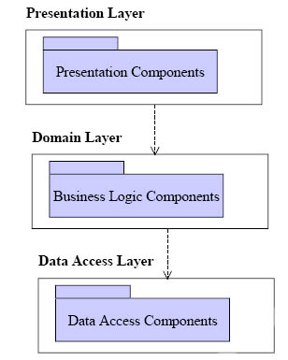

Slide 16
Software Architecture Document
Introduction
Architectural Representation
Architectural Goals and Constraints
Use-Case View
Logical View
Process View
Deployment View
Implementation View
Data View (optional)
Size and Performance
Quality

Slide 17
Architectural Goals and Constraints
The architecture will be formed by considering:
  functional requirements, captured in the Use-Case Model, and
  non-functional requirements, quality att.
However these are constraints imposed by the environment in which the software must operate that will shape the architecture :
  need to reuse existing assets
  imposition of various standards
  need for compatibility with existing systems

Slide 18
Software Architecture Document
Introduction
Architectural Representation
Architectural Goals and Constraints
Use-Case View
Logical View
Process View
Deployment View
Implementation View
Data View (optional)
Size and Performance
Quality

Slide 19
Architectural Structures and Views
In construction, there are blueprints of
  Plan , Different sides of construction , Electrical wiring , Plumbing, …
Each of these views specifies a single entity (i.e. the construction) from a different perspective (used by a different person, for a different goal).
Similarly there are different structures and views in SA.
View is a representation of software architecture based on an structure as written by the architect and read by stakeholders (an instance of the structure)
SA is documented by a number of views.

Slide 20
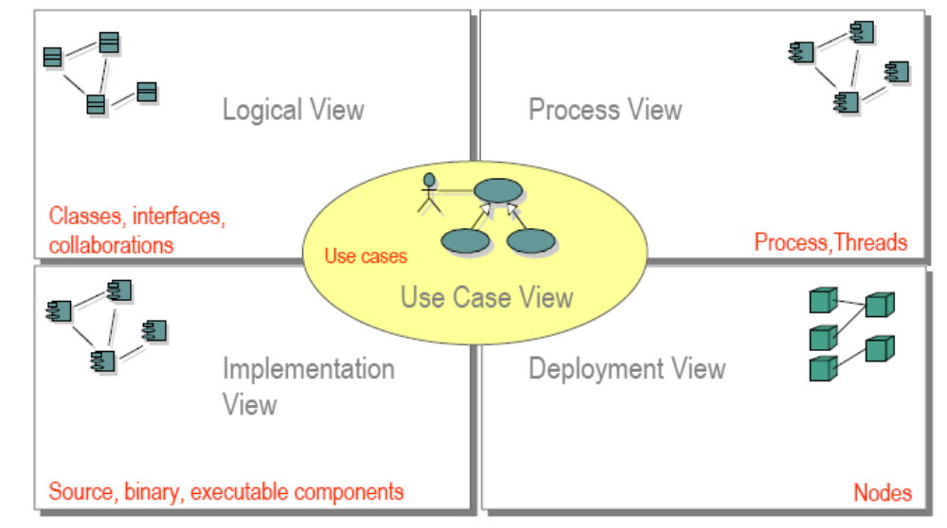
The “4+1” Views of Architecture

Slide 21
Use-case View
Contains only architecturally significant use cases (whereas the final use case model contains all the use cases).
  The logical view is derived using the use cases identified in the architectural view of the use case model.
Architecturally significant use cases:
  critical use cases, those that are most important to the users of the system (from a functionality perspective)
  use cases that carry the major risks
  use cases that have the most important quality requirements, such as performance, security, usability, etc.

Slide 22
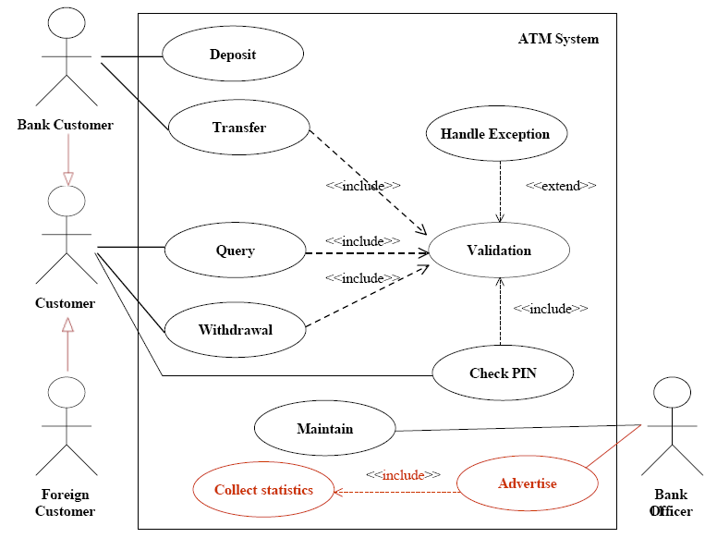
Use-case View : Example

Slide 23
Logical View
The Logical View is a subset of the Design Model which presents architecturally significant design elements
describes the most important classes
their organization in packages and subsystems
organization of these packages and subsystems into layers
It also describes the most important use-case realizations, for example, the dynamic aspects of the architecture

Slide 24
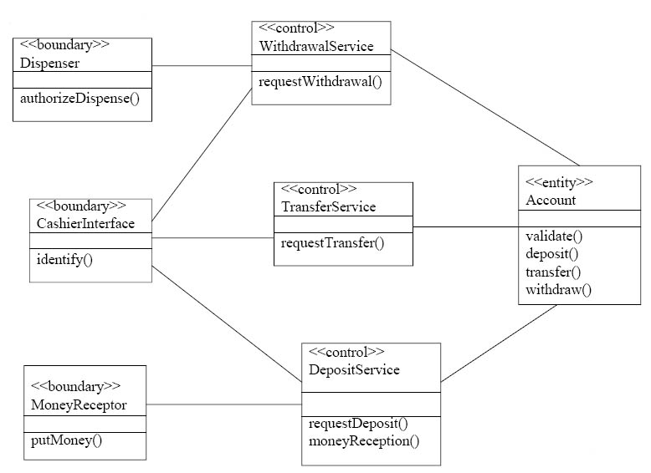
Logical View : Class Diagram

Slide 25
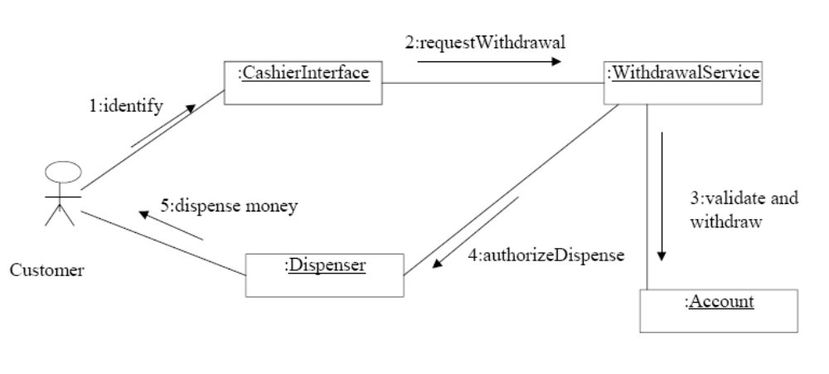
Logical View : Collaboration Diagram Deposit Use case

Slide 26
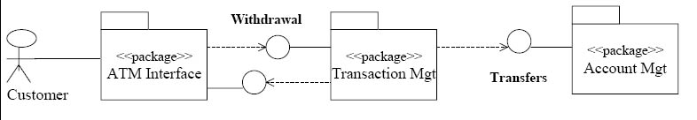
Logical View : Package Diagram

Slide 27
Process View
Consists of the processes and threads that form the system’s concurrency and synchronization mechanisms, as well as their interactions

Slide 28
Deployment View
This section describes one or more physical network (hardware) configurations on which the software is deployed and run.

Slide 29
Implementation View
Describes the organization of static software modules (source code, data files, executables, documentation etc.) in the development environment in terms of Packaging and layering
Are modeled using UML Component Diagrams.
UML components are physical and replaceable parts of a system that conform to and provide the realization of a set of interfaces

Slide 30
Software Architecture Document
Introduction
Architectural Representation
Architectural Goals and Constraints
Use-Case View
Logical View
Process View
Deployment View
Implementation View
Data View (optional)
Size and Performance
Quality

Slide 31
Size and Performance
The number of key elements the system will have to handle (the number of concurrent online users for an airline reservation system, …)
The key performance measures of the system, such as average response time for key events
Most of these qualities are captured as requirements; they are presented here because they shape the architecture in significant ways and warrant special focus. For each requirement, discuss how the architecture supports this requirement.

Slide 32
Quality
Operating performance requirements, such as mean-time between failure (MTBF).
Quality targets, such as "no unscheduled down-time"
Extensibility targets, such as "the software will be upgradeable while the system is running".
Portability targets, such as hardware platforms, operating systems, languages

